Slide 1

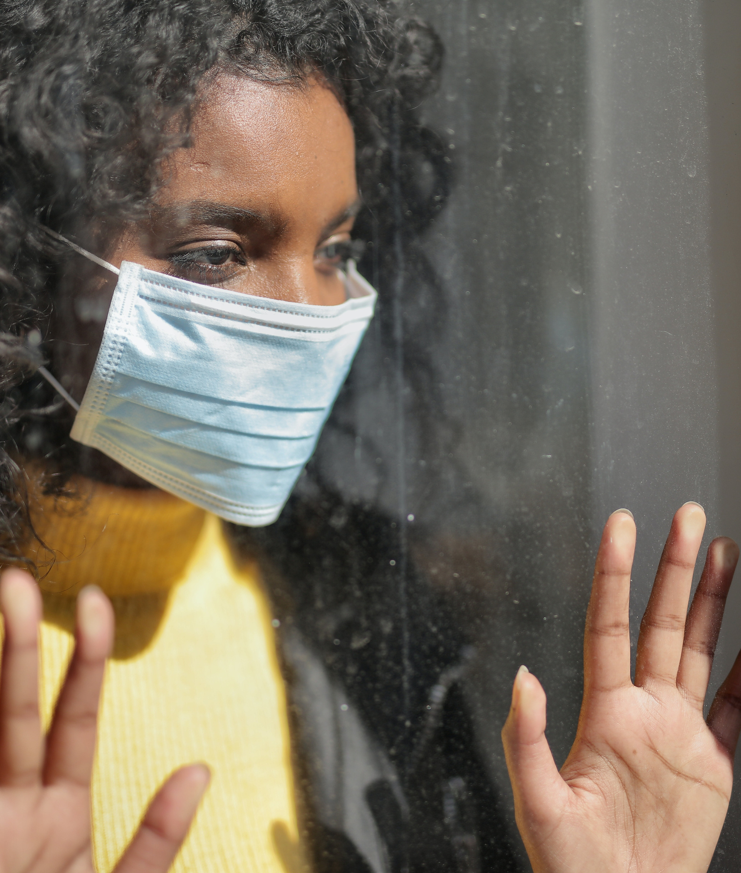


COVID-19 and the Experiences of Intimate Partner Violence Survivors and Service Providers
Family Violence Prevention Program All Agency Meeting
Ashley Haller, MHR & Kendra Nixon, PhD
November 28, 2023
Ashley Haller, MHR & Kendra Nixon, PhD

Slide 2

Acknowledgments
Community partner: Family Violence Prevention Program
Research team:
  Dr. Kendra Nixon, Principal Investigator, RESOLVE Network Director, and Professor, Faculty of Social Work, University of Manitoba
  Nadine Henriquez, Co-Investigator, Faculty of Health Studies, Brandon University
  Nadine Smith, Family Violence Prevention Program, Government of Manitoba
  Ashley Haller, Project Coordinator, RESOLVE Manitoba, University of Manitoba
  Bright Thorsteinson, Kathleen McDonald, Riley Hammond, Lilja Best, and Karen Power (Research Assistants)
Research advisory committee:
  Deena Brock, Provincial Coordinator, Manitoba Association of Women’s Shelters Inc.
  Lori Rudniski, Executive Director, Bravestone Centre
  Katina Cochrane, Executive Director, First Nation Healing Centre
  Michele Nichol-Sawh, Director, Men Are Part of the Solution (MAPS)
  Fatima Siyawareva, Director, Family Violence Program, NorWest Co-Op Community Health
  Ivory Stevenson, Program Support Specialist, Wahbung Abinoonjiiag Inc.
  Aerlan McDougall, Counsellor, The Women’s Resource Centre
Project funder: Social Sciences and Humanities Research Council (SSHRC)

Slide 3
Purpose
The COVID-19 pandemic was the first pandemic to occur in nearly 100 years
Drastic measures were necessary to prevent the spread of the virus, but they inadvertently exacerbated another public health epidemic—intimate partner violence (IPV)
IPV quickly became known as the “shadow pandemic” or a “pandemic within a pandemic”

Slide 4
Objectives
Project was developed in partnership with RESOLVE Manitoba and the Family Violence Prevention Program to better understand how pandemics, such as COVID-19, impact survivors of IPV and organizations that serve them in Manitoba
Research objectives:
  Establish a foundational understanding of the impact of pandemics on the social issue of IPV
  Explore the impact of pandemics on IPV survivors
  Identify how pandemics can put IPV survivors at additional risk
  Explore the impacts of pandemics on IPV service providers
  Explore how IPV-serving organizations in Manitoba responded to COVID-19, including what barriers they encountered
  Develop policy and practice recommendations for policymakers/service providers

Slide 5
Methods
Data sources:
  Online survey with service providers (75 participants)
  Follow-up interviews with service providers (nine participants)
  In-depth interviews with survivors of IPV (23 participants)
Analysis
  Survey data analyzed using quantitative analysis software SPSS
  Interview data analyzed using qualitative analysis software (Dedoose)
  Qualitative data was coded over a four-month period and a thematic analysis was conducted to outline emerging themes

Slide 6
Findings: Abuse and Injury
IPV increased in frequency and severity
New tactics of abuse
  E.g., using “stay at home” orders to further isolate survivors, lying about available services, destroying materials needed to work from home
At the beginning of COVID, you know, he was still really abusive, like emotionally, mentally, and verbally at the beginning, but it wasn't as severe or as frequent. But by the end of it, by the end of things, it was every day, every single day. And every day it was worse than the previous day. (Survivor 20)
My laptop and my cell phone [were destroyed]. I wasn't able to work for a good month. I actually had to pretty much get my work to buy me a laptop and then get money taken off of my pay cheques to be able to work from home.
(Survivor 13)

Slide 7
Findings: Co-Occurring Issues
Mental health
  88% of service providers noticed a deterioration in the mental health of survivors
Substance Use
  56% of service providers noted increases in survivor substance use
  42.7% of service providers noted increases in perpetrator substance use
Food insecurity
Mental health… underscore 85 times. Increasingly severe mental health issues where women are actually getting to the point of needing to be hospitalized before coming to shelter. (Service Provider 02)
Addictions is through the roof. I don't know if we've had a client in here in the last two months that hasn't been addicted to some kind of substance. (Service Provider 07)

Slide 8
Findings: Barriers to Seeking Help
Unique barriers to help-seeking during the pandemic:
  The impact of lockdown or “stay at home” orders and a lack of privacy
  Overwhelmed services
  Confusion surrounding the availability of services
  Lack of access to internet or technology, difficulty navigating online services
  Fears of contracting the COVID-19 virus
  Vaccination status
Unique barriers were experienced on top of “pre-existing” barriers
For me it was just having that privacy to talk about it. Because whenever I was on my phone or talking to someone on my phone, he was like who is that? Or even if I was on my phone, he would always be like if you are always on your phone, who are you talking to now? So that was a barrier. (Survivor 09)
For people that don't know anything about online shit, it makes it harder and more stressful and frustrating to navigate. (Survivor 06)

Slide 9
Findings: Changes to Service Provision
Changes to service provision during the COVID-19 pandemic included:
  Safety protocols/public health orders
  Increases/decreases in services and programming
  Implementing online services
  Longer shelter stays
  The use of hotels to accommodate increased demand
  Non-IPV-related services and programming
We developed a whole program now which can be done virtually, which is actually very helpful and that has also enabled us to reach out to a lot more women. (Service Provider 05)
Normally we would only maybe have to put our male callers into hotels. We were using hotels quite a bit throughout, say, April of 2021 right through to July of this year, we were over capacity. (Service Provider 08)

Slide 10
Findings: Challenges to Service Provision
Challenges to service provision during the COVID-19 pandemic included:
  Navigating changing public health orders
  Increased (and fluctuating) service demand
  Staffing/staff illness
  Fears of contracting the virus
  Communal living environments at shelters
  Funding
I just needed somebody to give me the Coles Notes on, OK do I need to change anything today? I think in healthcare they had something like that, but we did not have that. So, there was, you know, there's 10 shelters in the province, there was 10 of us constantly wasting a lot of time doing that, which was ridiculous. (Service Provider 06)
Well staff illness. We had 50% of our staff go down over Christmas and then into January with COVID. We were very, very close to actually having to temporarily shut and move people away. (Service Provider 02)

Slide 11
Findings: Impacts on Service Providers
Increased stress and burnout
  65.3% experienced increased stress
  45.3% experienced burnout
Mental and physical health
  54.7% dealt with mental or physical health concerns
Feelings of isolation
  60% felt isolated from informal supports (friends, family, co-workers)
I found a lot of people were dealing, myself included, with increased levels of anxiety. To the point where it actually was impacting us at work and at home. Sometimes you just wake up feeling anxious and you didn't know why. There was a lot of pressure in our work roles. (Service Provider 02)
My parents live in [name of city]—couldn't visit them. Most of my family's there. My other brother is in [name of province], we couldn't visit at all. […] So yeah, it brought me down. It definitely brought me down. I stopped, as I say I sort of hermitized myself, I just stayed inside and got down, low. (Service Provider 04)

Slide 12
Findings: Needed Resources, Knowledge, and Skills
Top resources:
  Additional funding
  More staff
  Increased collaboration with other agencies
Top knowledge and skills:
  Self-care
  Supporting staff in times of crisis/uncertainty
  Health-related/pandemic information

Slide 13
Recommendations
Utilize technology for online services and address barriers to digital access
Develop innovative methods to connect with survivors and implement holistic services
Invest in IPV services, supports, and resources
Strengthen collateral system responses to IPV and foster coordination
Support service providers
Implement gender-specific emergency response measures
Increase public awareness of IPV and pandemic supports
Increase data on IPV in the context of emergent or crisis events

Slide 14


Resources
Literature review
Final report
Summary report
Policy brief
Practice brief

Slide 15
Contact Us
RESOLVE
108 Isbister Building
University of Manitoba
(FG Campus)
E: resolve@umanitoba.ca
P: 204-474-8965
Kendra Nixon
E: kendra.nixon@umanitoba.ca
P: 204-474-9292
Ashley Haller
E: ashley.haller@umanitoba.ca
P: 204-474-7995

Slide 16





Stay in Touch
@resolveumanitoba
@resolveum
@resolveum
http://www.umanitoba.ca/resolve/
resolve@umanitoba.ca

